Slide 1
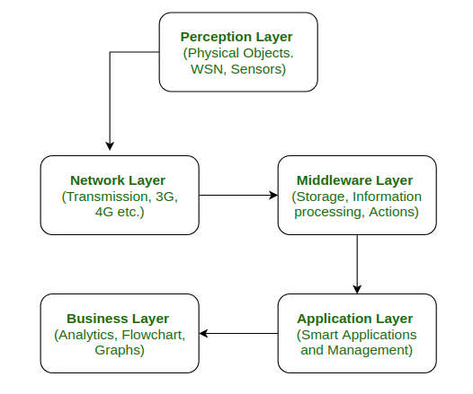
IoT Network Architecture

Slide 2
1. PERCEPTION LAYER
In the perception layer, a number of sensors and actuators are used to gather useful information.
The main function of this layer is to get information from surroundings and to pass data to another layer so that some actions can be done based on that information.

Slide 3
2. Network Layer
It is the connecting layer between perception and middleware layer. It gets data from perception layer and passes data to middleware layer using networking technologies like 3G, 4G etc.
This is also called communication layer because it is responsible for communication between perception and middleware layer. All the transfer of data done securely keeping the obtained data confidential.

Slide 4
3. Middleware Layer
Middleware Layer has some advanced features like storage, computation, processing, action taking capabilities.
It stores all data-set and based on the device address and name it gives appropriate data to that device.
It can also take decisions based on calculations done on data-set obtained from sensors.

Slide 5
Application Layer
The application layer manages all application process based on information obtained from middleware layer. This application involves sending emails, activating alarm, security system, turn on or off a device, smartwatch, smart agriculture, etc.

Slide 6
Business Layer
The success of any device does not depend only on technologies used in it but also how it is being delivered to its consumers. Business layer does these tasks for the device.
It involves making flowcharts, graphs, analysis of results, and how device can be improved, etc.

